Slide 1
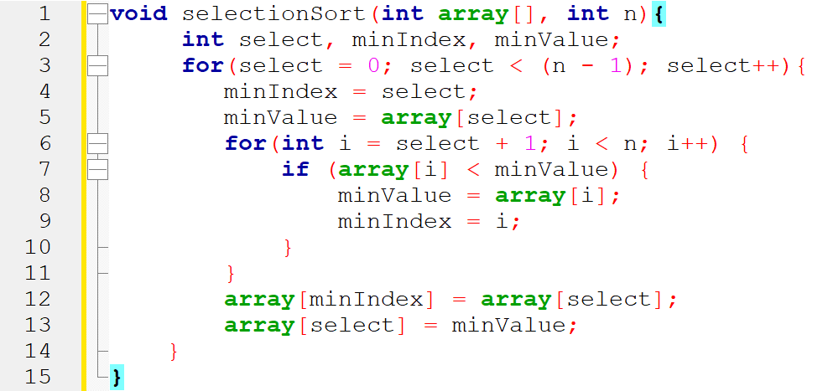
index | 0 | 1 | 2 | 3 | 4 | 5 | 6 | array
value | 12 | 16 | 84 | 42 | 77 | 26 | 53
Line 2: select, minIndex, minValue
Line 3: for(select=0;select<6;select++), select=0
Line 4: minIndex= select, minIndex=0
Line 5: minValue= array[select] minValue= array[0]= 12
Line 6: for(i=1; i<7;i++) , i=1
Line 7: if( array[1] < minValue) if(16 < 12)
Line 6: for(i=1; i<7;i++) , i=2
Line 7: if( array[2] < minValue) if(84 < 12)
Line 6: for(i=1; i<7;i++) , i=3
Line 7: if( array[3] < minValue) if(42 < 12)

Slide 2
index | 0 | 1 | 2 | 3 | 4 | 5 | 6 | array
value | 12 | 16 | 84 | 42 | 77 | 26 | 53
Line 2: select, minIndex, minValue
Line 3: for(select=0;select<6;select++), select=0
Line 4: minIndex= select, minIndex=0
Line 5: minValue= array[select] minValue= array[0]= 12
Line 6: for(i=1; i<7;i++) , i=4
Line 7: if( array[4] < minValue) if(77< 12)
Line 6: for(i=1; i<7;i++) , i=5
Line 7: if( array[5] < minValue) if(26 < 12)
Line 6: for(i=1; i<7;i++) , i=6
Line 7: if( array[6] < minValue) if(53< 12)

Slide 3
index | 0 | 1 | 2 | 3 | 4 | 5 | 6 | array
value | 12 | 16 | 84 | 42 | 77 | 26 | 53
Line 2: select, minIndex, minValue
Line 3: for(select=0;select<6;select++), select=1
Line 4: minIndex= 1
Line 5: minValue=16
Line 6: for ( 2--------6)

Slide 4
index | 0 | 1 | 2 | 3 | 4 | 5 | 6 | array
value | 12 | 16 | 84 | 42 | 77 | 26 | 53
Line 2: select, minIndex, minValue
Line 3: for(select=0;select<6;select++), select=2
Line 4: minIndex= 2
Line 5: minValue= array[2]= 84
Line 6: for( i=3;i<7;i++) , i=3
Line 7: if(array[3] < minValue) if( 42<84) --- true
Line 8: minValue= 42 minIndex = 3
Line 6: for( i=3;i<7;i++) , i=4
Line 7: if(array[4] <minValue) if( 77 <42)

Slide 5
index | 0 | 1 | 2 | 3 | 4 | 5 | 6 | array
value | 12 | 16 | 26 | 42 | 53 | 77 | 84
Line 6: for( i=3;i<7;i++) , i=5
Line 7: if( array[5] < minValue) if( 26 < 42) -- true
Line 8 : minValue= 26
Line 9: minIndex= 5
Line 6: for( i=3;i<7;i++) , i=6
Line 7: if( array[6] < minValue) if( 53 < 26) -- false
Line 12: array[5]=array[2]
Line 13: array[2] = 26

